Slide 1



Source code on GitHub
ElevenClock
Have a customizable clock on your Windows 11 displays
100% Free, Forever
The SomePythonThings Project

Slide 2
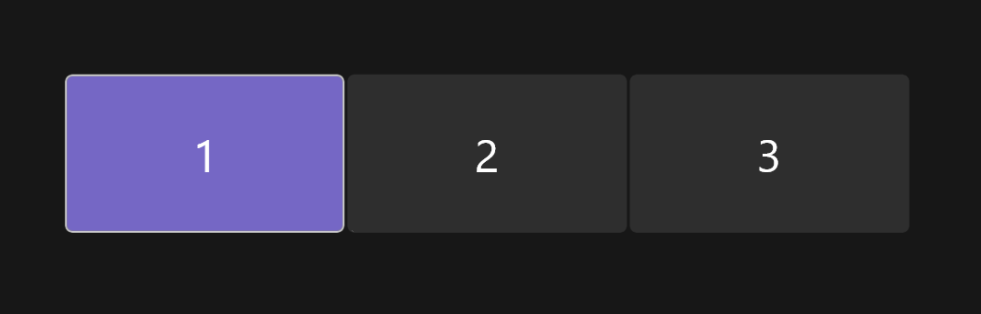
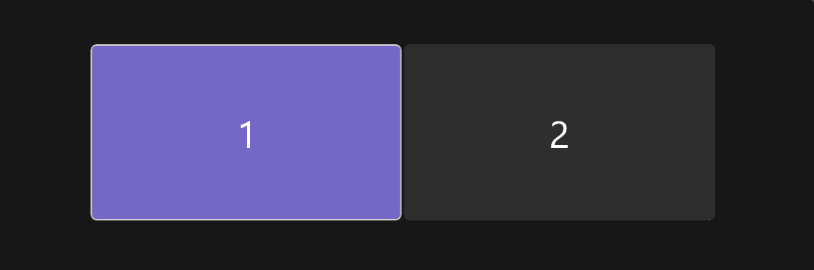
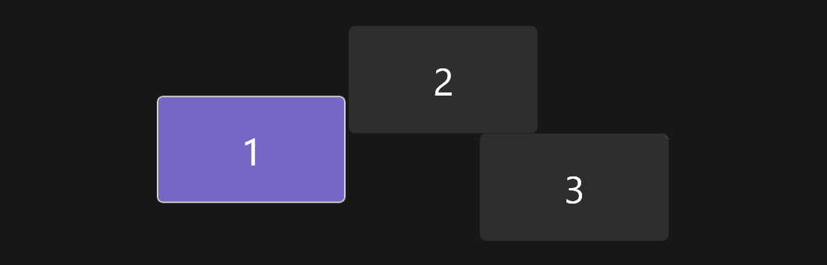



Supports all alignments:
ElevenClock supports any screen arrangement: Vertical, Horizontal, Diagonal, Custom...
2, 3, 4 displays... People with 10 displays have reported ElevenClock to work on all of them

Slide 3
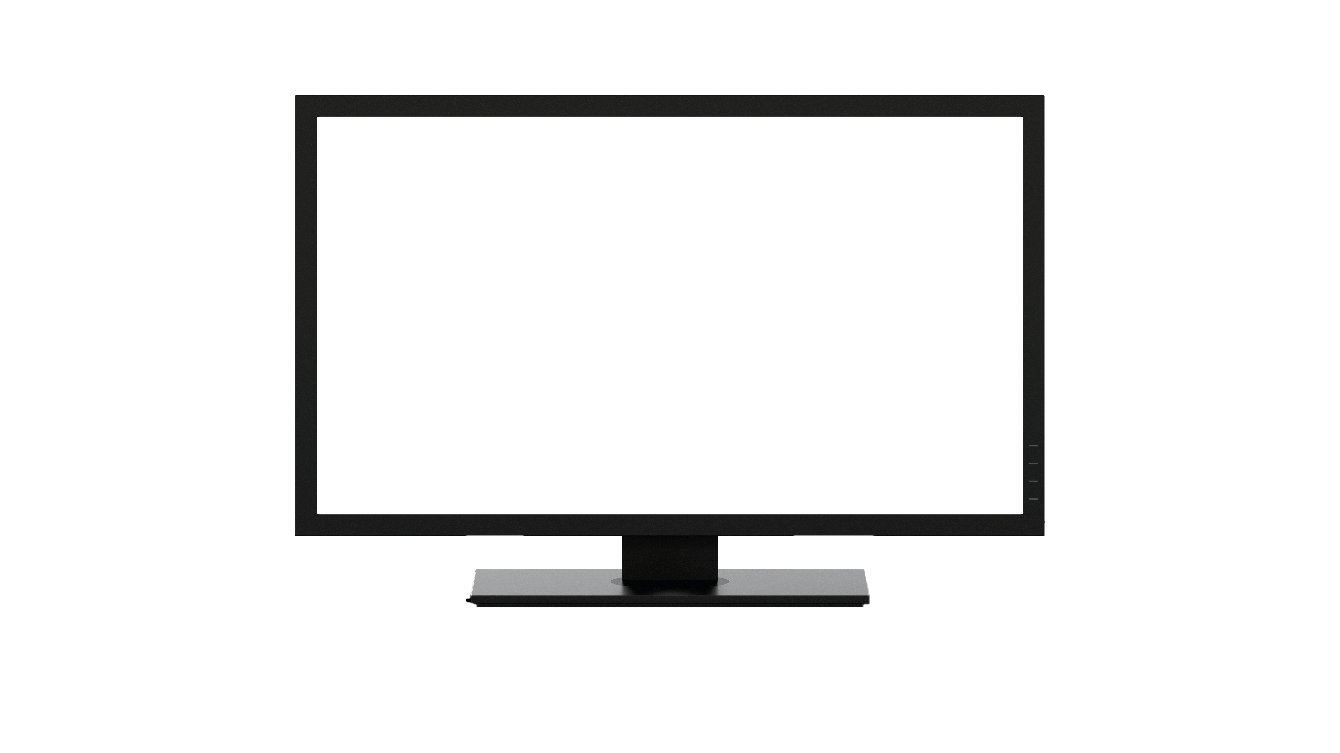
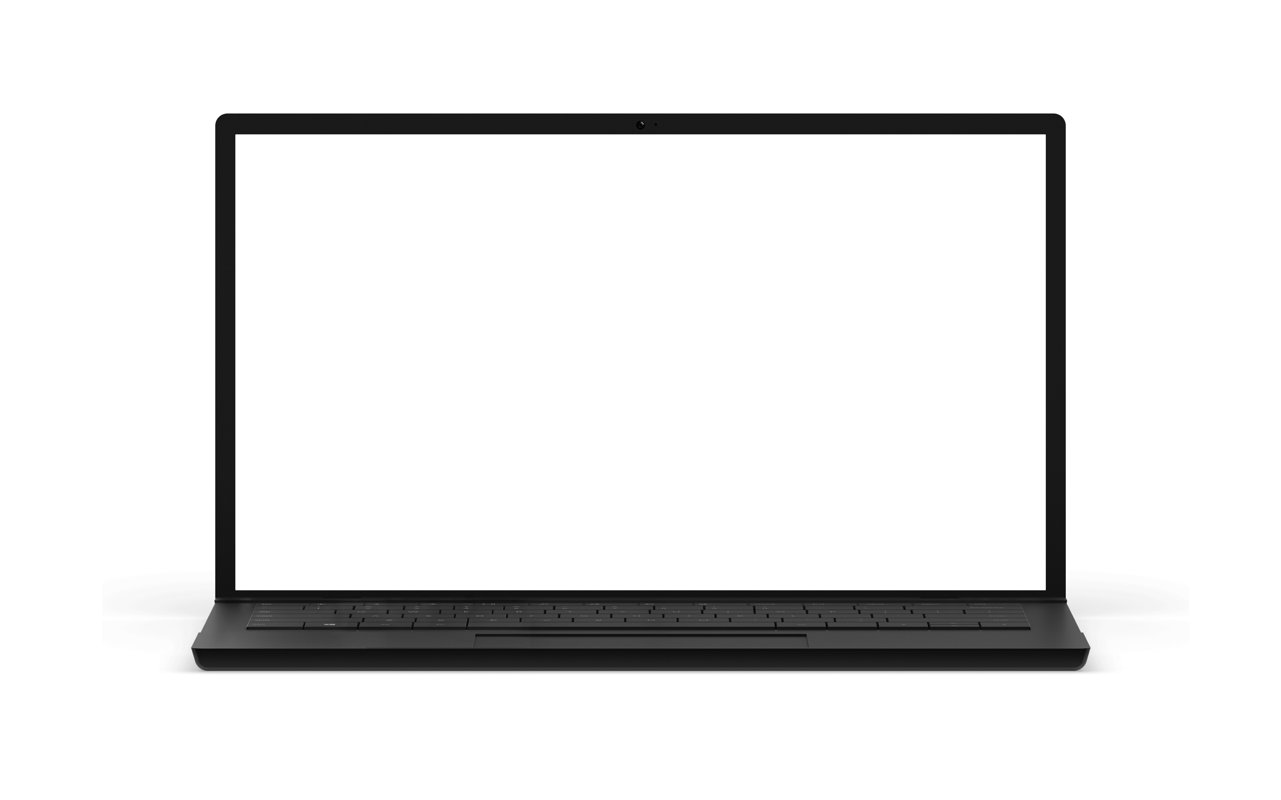
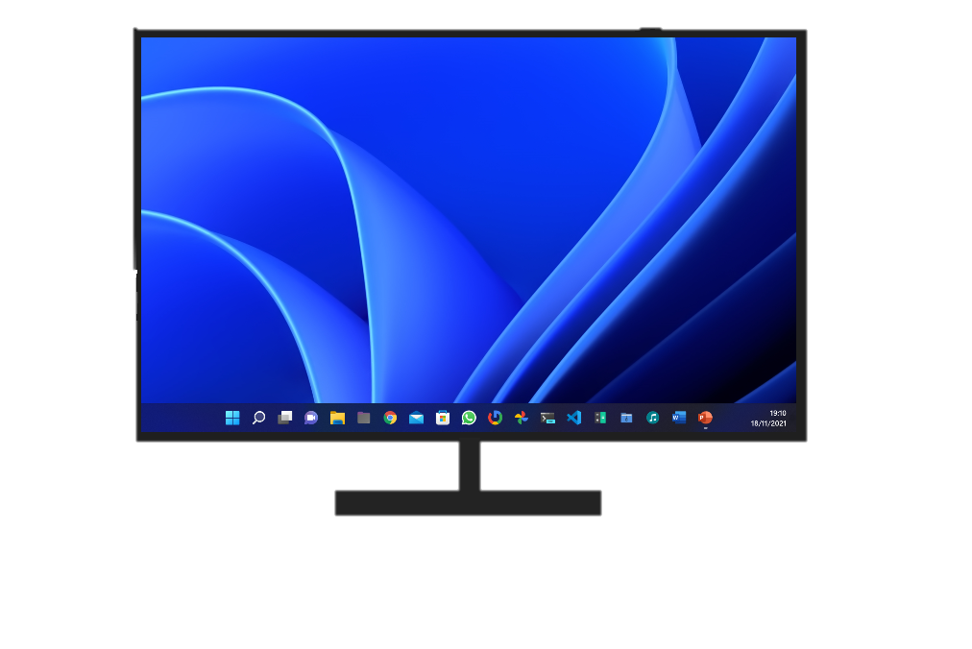
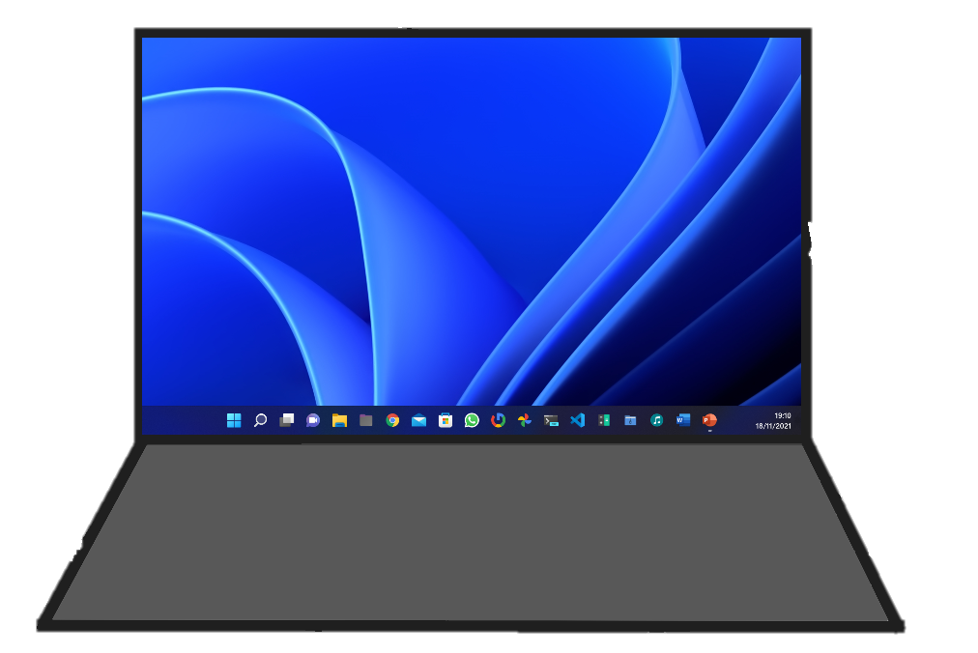
Do you have a laptop?
ElevenClock will show and hide on each display depending whether you connect or disconnect monitors

Slide 4
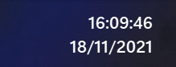



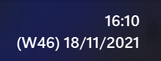

Format Customization:
Add Seconds: |  | Show only the date:
Add Weekday: |  | Show only the time:
Add Week number: |  | Your custom choice:

Slide 5
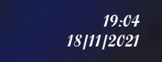
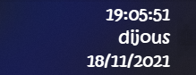
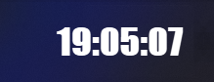
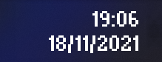
Font Customization:
Alternative font: |  | Hand-drawn clock:
Impacting time: |  | For the MS-DOS fans:

Slide 6
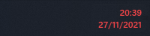
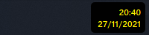

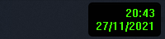
Color Customization:
Red mode: |  | Nuclear clock:
Sea mode: |  | Retro clock:
You can customize ElevenClock’s look and feel to make it yours

Slide 7
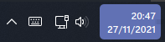
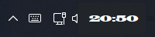
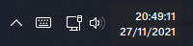
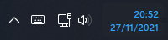
Replace System Clock
You can now replace System Clock in order to customize it
Accent color: |  | Wide clock:
Add seconds: |  | Blue clock:

Slide 8
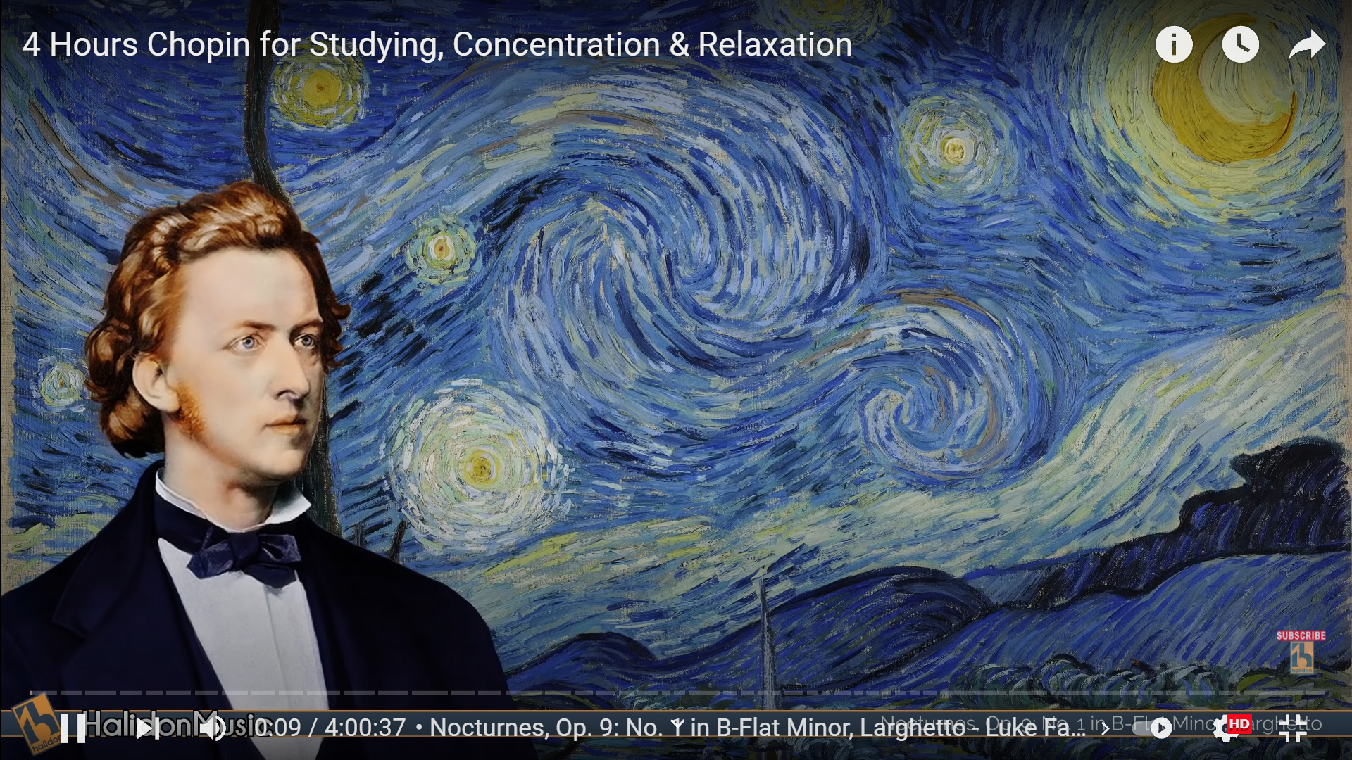

Automatically hide (Or not):
ElevenClock can be set to hide with fullscreen Windows But it can also be set to show over them!

Slide 9
Move the clock to the left
ElevenClock displays on the right corner of your screen by default
But it can be moved to the left side easily
Also, if your taskbar is on the top, ElevenClock will be shown on the top, but it can be set to show on the bottom

